Slide 1
Flagship projects
www.sozialmarie.org sozialmarie@sozialmarie.org

Slide 2
Social Housing Reconstruction Camp
by the Foundation for the College
for Advanced Studies in Social Theory,
in Nagykanizsa (Hungary)
1st prize in 2011
www.szepitotabor.hu

Slide 3
Social Housing Reconstruction Camp
Volunteers reduce housing shortage
Project:
Since 2009
Some 500 people are living in the buildings of a former military hospital in the town of Nagykanizsa, Western Hungary
A group of young politically motivated people from Budapest are organising working camps
Over 100 Hungarian and international volunteer workers are teaming up with locals on-site to renovate rundown social apartments and fit better insulation
A contract with the local community enables the tenants to reduce their rent and prevents them from having to move to the slum dwellings on the edge of the settlement

Slide 4
Social Housing Reconstruction Camp Volunteers reduce housing shortage
Why innovative?
The shortage of housing is a widespread symptom of poverty in Hungary. These students have noted the problem and developed a project with multiple impacts:
houses are being renovated
energy costs slashed and rent arrears reduced
collaboration with (inter)national volunteers has injected new life into the settlement
the community is exchanging rent arrears for an improvement in the value of the housing stock
fantastic political and social sensitivity is developing into concrete support

Slide 5
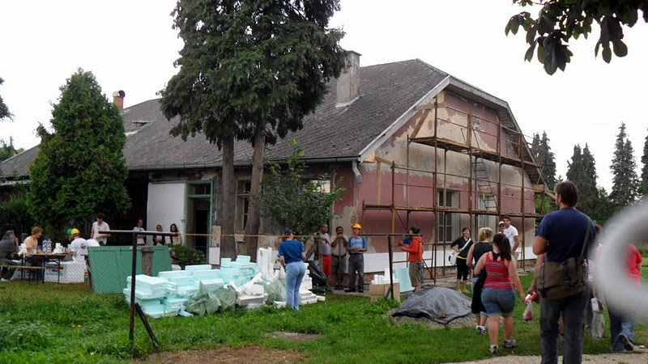
Day 1

Slide 6
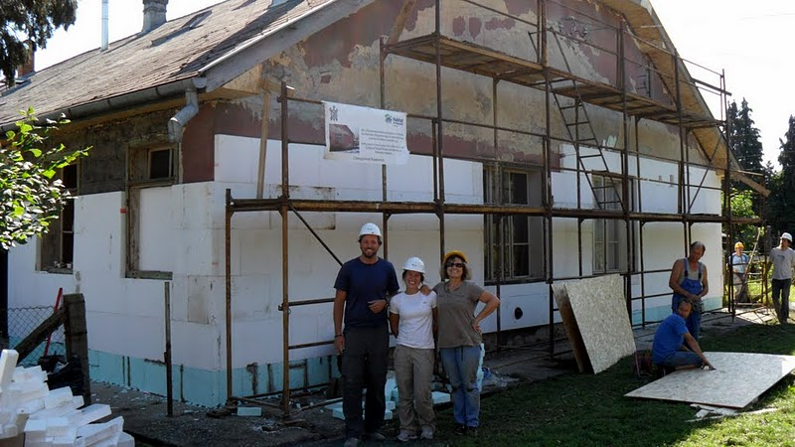
Day 2

Slide 7
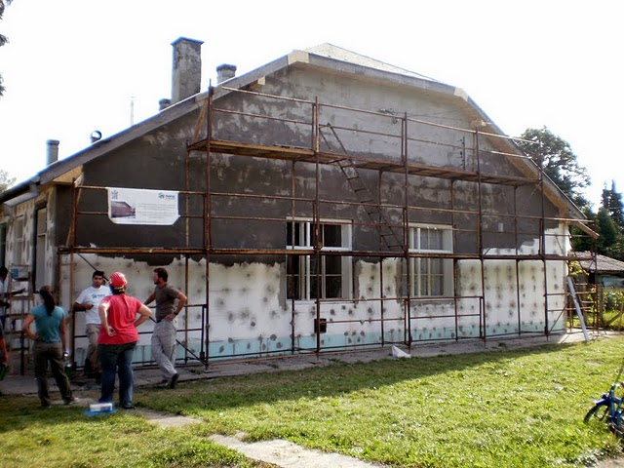
Day 5

Slide 8
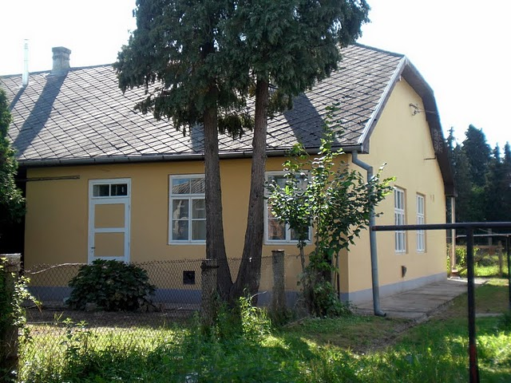
Day 16

Slide 9
Children’s Hospice Network
by Verein Netz, in Vienna
1st prize in 2012
www.kinderhospiz.at

Slide 10
Children’s Hospice Network
Project:
Since 2010
Approximately 600 children die after long suffering in Austrian emergency hospitals. These hospitals can usually offer only a limited possibility to care for the needs of these children and their families.
Children´s Hospice Network offers families with terminally ill children or adolescents free medical and nursing care, as well as psychosocial care, including the financial and practical aspects of everyday life.
The sick children themselves are distinguished from their siblings and relatives. In addition to paid specialists and children’s hospital nurses, 22 specially trained volunteers assist in delivering mobile-ambulatory care.
External services, especially, are also coordinated, namely paediatricians, paediatric intensive care stations, the youth welfare office, the police, and schools/kindergartens.
To date, more than 20 families have been assisted, to varying degrees, including after the death of their child in some cases.
The Network is financed almost exclusively through private donations.

Slide 11
Children’s Hospice Network
Why innovative?
The children's hospice network is unique in German-speaking countries in providing this combination of services.
What is of central importance is that the illness is not considered in isolation from its social context. The work of the children’s hospice team is needs-driven. Instead of erecting parallel structures, it creates ones that are connected and complementary.
It highlights the need for health policy action in the field of palliative and terminal care for children and adolescents.
The network strives to integrate children’s palliative care into the public health system through its own advocacy work, which is in part political.

Slide 12
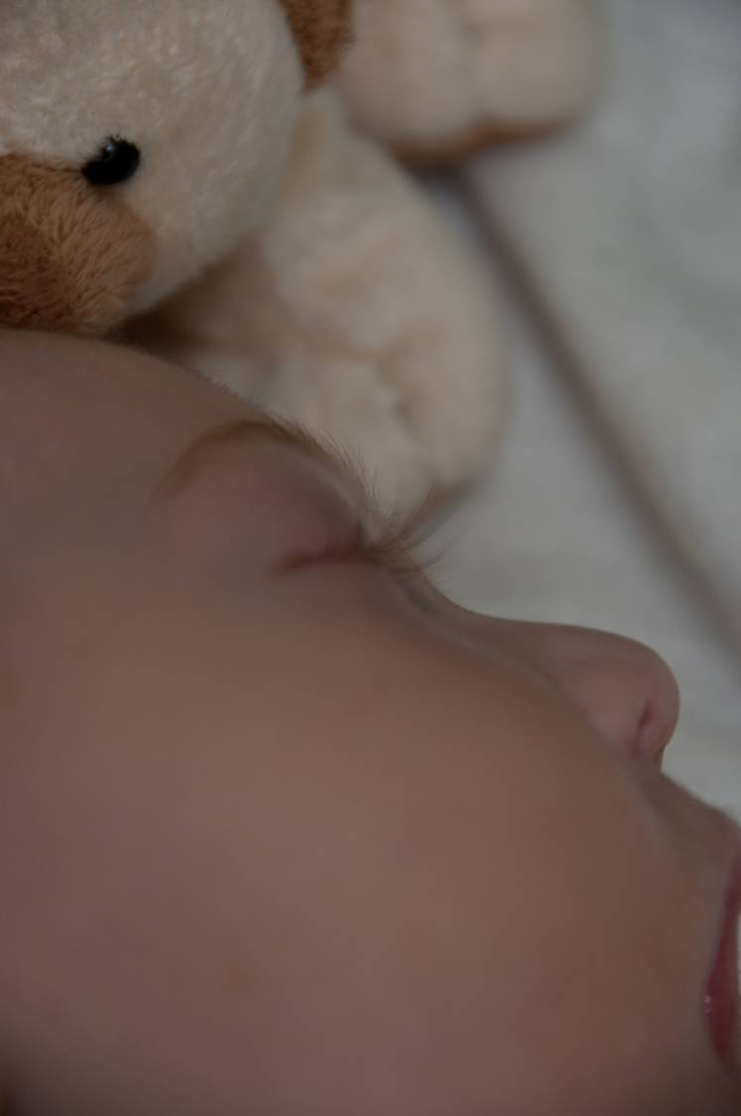
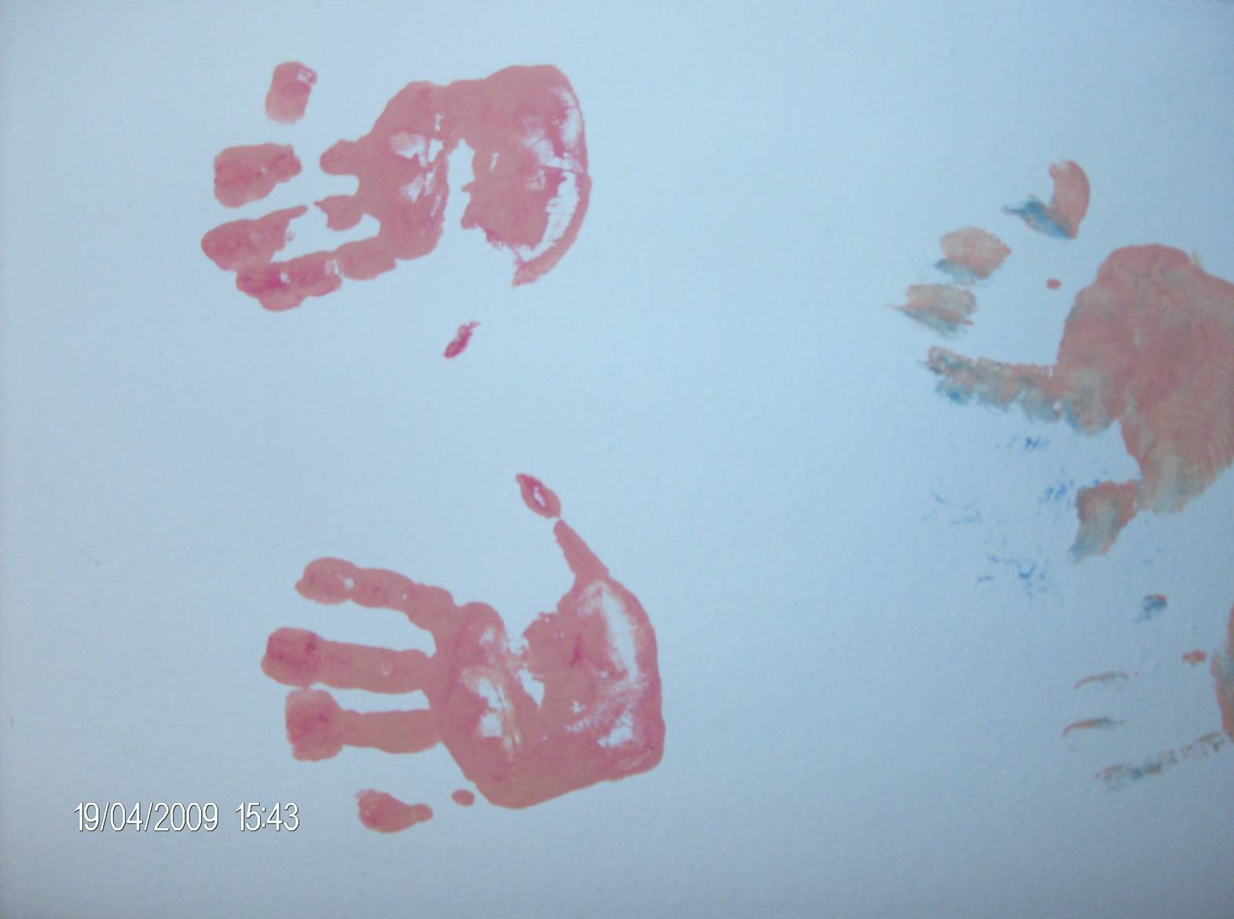

Slide 13
Next Door Family
by Slovo 21, Prague
2nd prize in 2011
www.slovo21.cz
www.nextdoorfamily.eu

Slide 14
Next Door Family
Project:
Since 2004
Immigration is currently one of the biggest social problems in the EU. It is necessary to look for and create new ways of enhancing intercultural dialogue and apply new integration approaches that can shorten the distance between the majority and immigrants, as well as prevent the emergence of bias against immigrants, extremist and hateful utterances.
The project takes the form of casual lunches whereby immigrant families living permanently in the Czech Republic meet up with Czech families from their neighborhood. The project presents an innovative and new approach of integrating immigrants into majority society.
The project involved more than 6000 people between 2004 and 2011 and helped many families to live in “friendly neighbourhoods”.

Slide 15
Next Door Family
Why innovative?
These organised gatherings would probably not take place otherwise but have a wider-reaching impact: in half of all cases, things do not end with just one lunch.
A documentary film is spreading the idea and the media are reporting on this kind of Czech-migrant interaction.

Slide 16
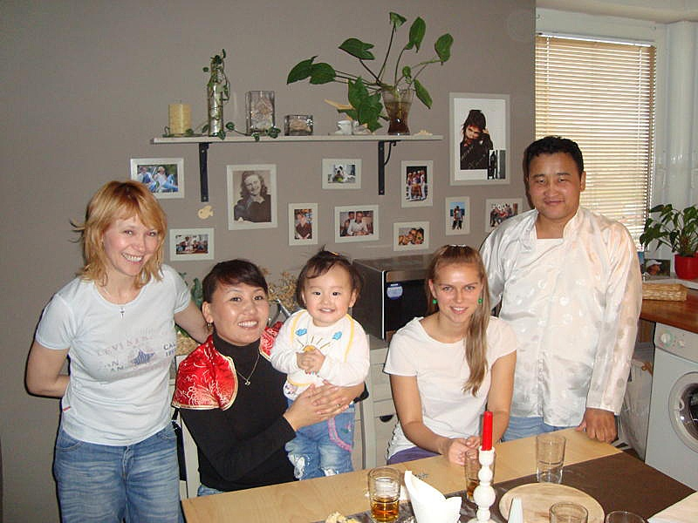
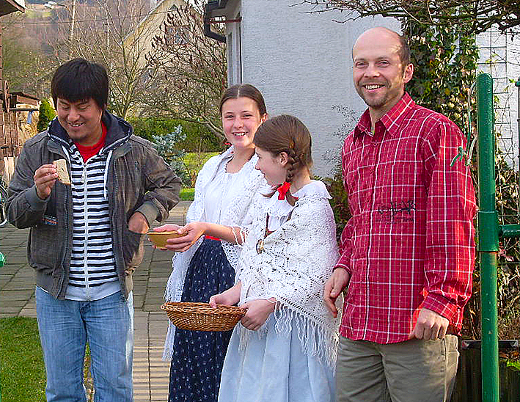
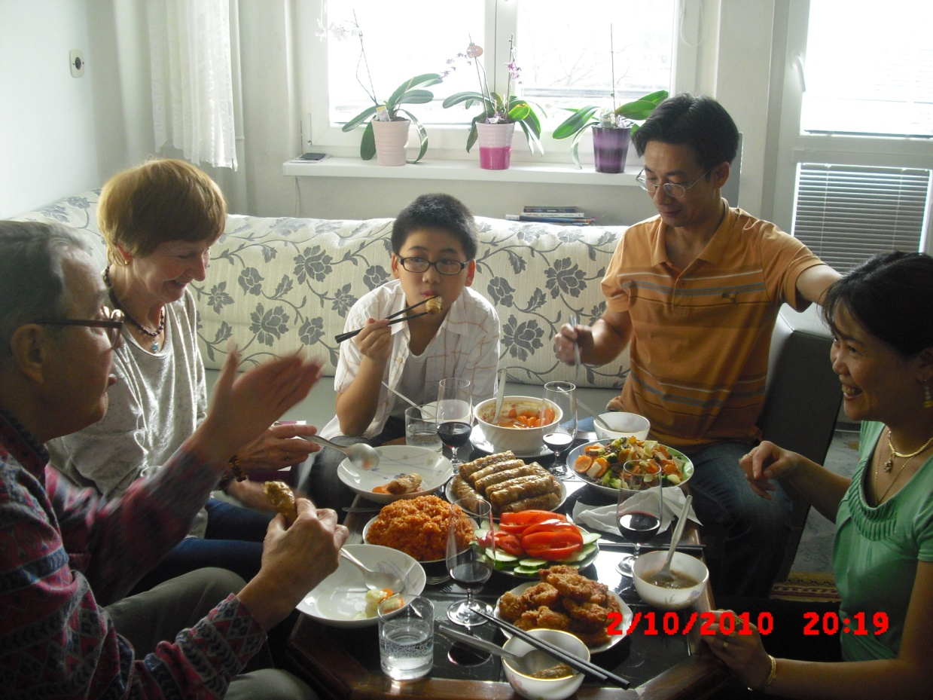

Slide 17
LebensDESIGN
by Lebenshilfe Salzburg
2nd prize, 2010
www.lebensdesign.eu

Slide 18
LebensDESIGN
Project:
since 2008
About 70 people with learning disabilities or multiple disabilities produce high-quality designer products made of wood, clay, wax and textiles in the furniture, lamps, accessories and games sectors in Lebenshilfe Salzburg’s workshops.
Products are designed by students on the Design and Product Development course at Salzburg University of Applied Sciences, under the guidance of the senior designer of the Porsche Design Studio.
Central requirement: at least 80% of the production steps are carried out by people with learning disabilities under production conditions similar to those of normal manufacturing processes.
Porsche car dealers and Porsche design shops are sales partners. LebensDESIGN has become a brand in its own right.

Slide 19
LebensDESIGN
Why innovative?
Two worlds with completely different focuses are working together. The aim of this working relationship is to contradict the image that society, i.e. all of us, have of people with disabilities and their capabilities. People with disabilities are producing luxury goods.
The budding designers of the University of Applied Sciences consider the production conditions of workshops for people with disabilities.
The Porsche Design Studio can show its creativity in a completely different way.
I do not buy LebensDESIGN products out of pity, but because of the brand.

Slide 20
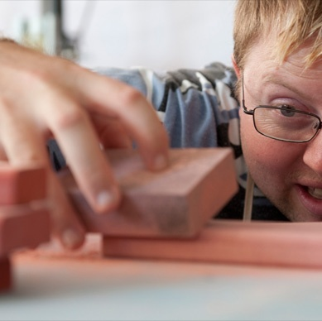
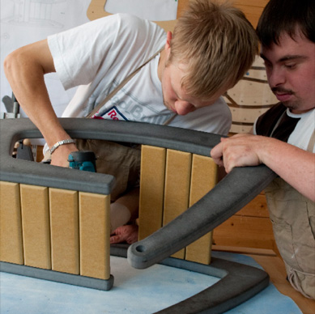
LebensDESIGN

Slide 21
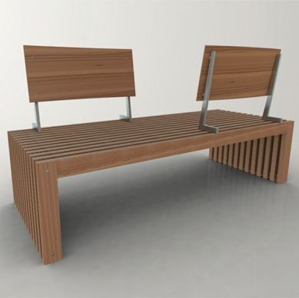
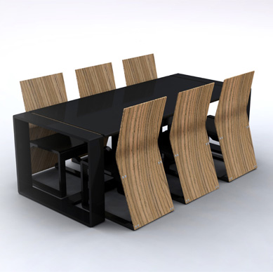
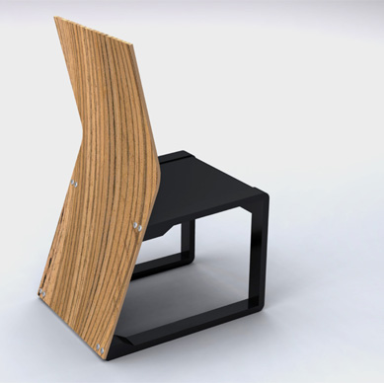

Slide 22
Living Books
by Verein "living books –
Miteinander reden statt übereinander“,
in Vienna
1st prize, 2008
www.livingbooks.at

Slide 23
Living Books
Project:
Since 2007
living books is a dialogue platform that functions like a public library. However, „books“ are people who are confronted with prejudice.
„Readers“ (visitors) can „borrow“ these „books“ on site for personal discussions free of charge.
Examples for „book titles“: imam, Jew, policeman, African asylum seeker, astrologist.

Slide 24
Living Books
Why innovative?
People can come to terms with their own clichés in a playful, quick and quiet way. „Living library“ adapts itself well to any public space, opens it up for an intercultural dialogue in the broadest sense.
Impressive, how provocatively, sensitively, easily encounter in diversity can be offered: appreciation, openness, interest without the intention to convince make as a consequence life easier…

Slide 25
