Slide 1

www.sozialmarie.org sozialmarie@sozialmarie.org
od roku 2005
1,750 přihlášek projektů

Slide 2
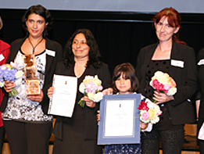
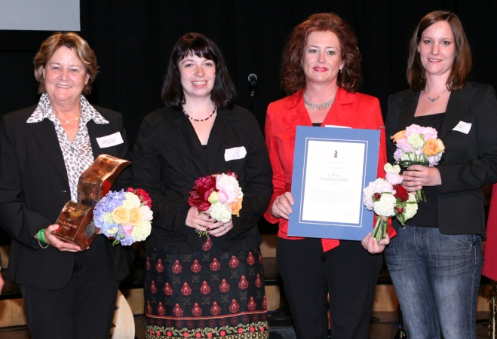
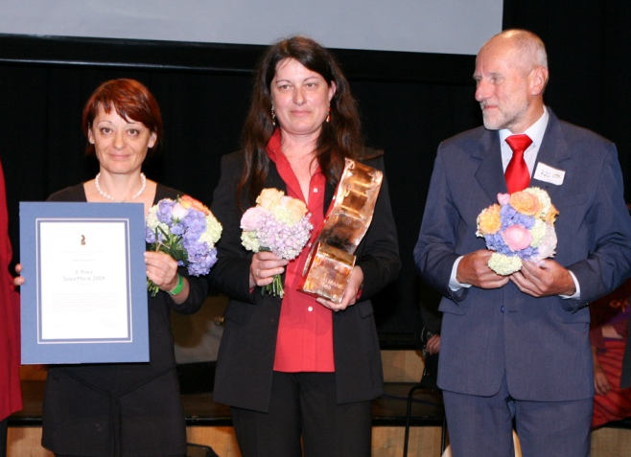
2009
1st prize
School Enrolment & Community Action in Csörög Hungary
2nd prize
A Future for Everyone
Austria
3rd prize
Death of a Close Family Member or Friend
Austria

Slide 3
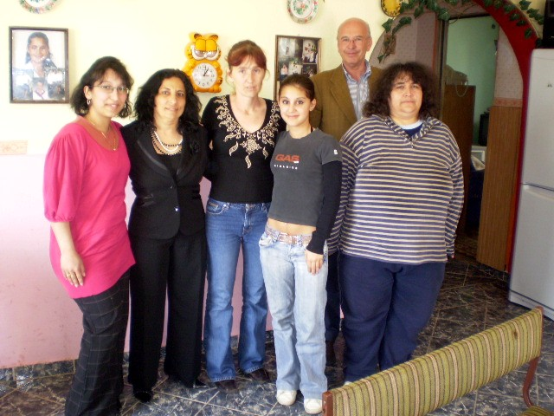
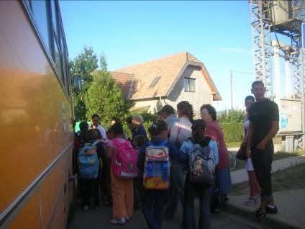
1st prize
2009
School Enrolment & Community Action in Csörög Hungary
Roma mothers fight the illegal segregation of their children
Points to the apartheid-like educational structure
To force the decision-makers to uphold the law

Slide 4
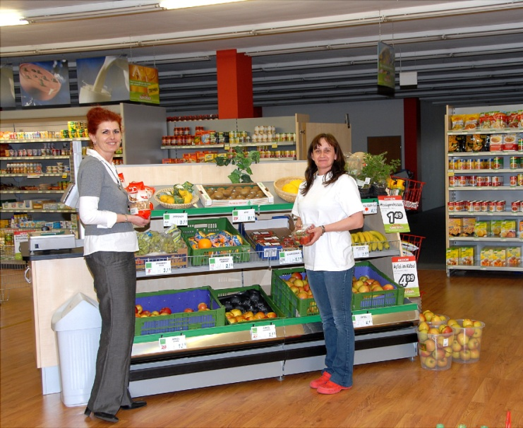
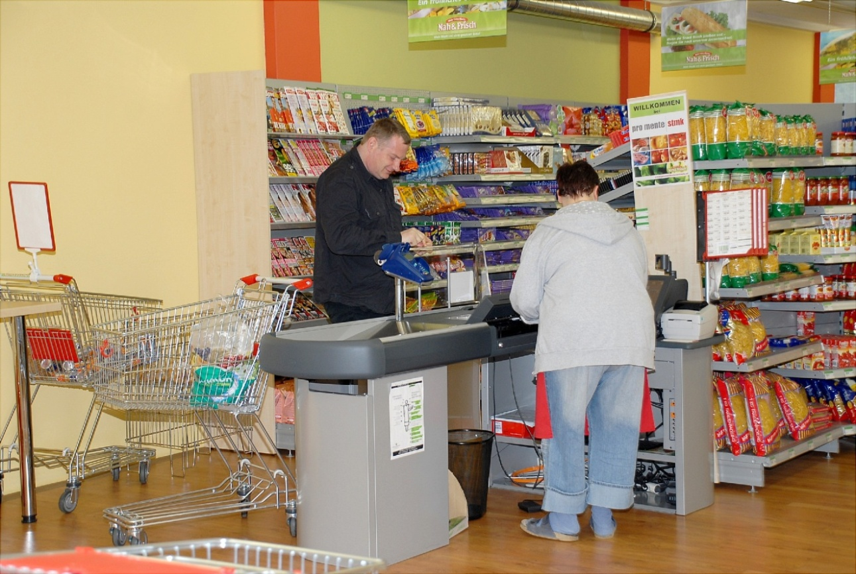
2nd prize
2009
A Future for Everyone
Austria
A municipality tackles the New Poverty
Successful combination of material aid and political
sensibilisation
Social inclusion without 'poverty-exhibition'

Slide 5
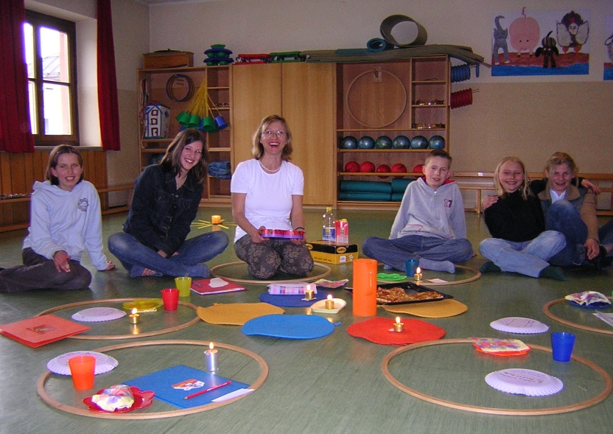
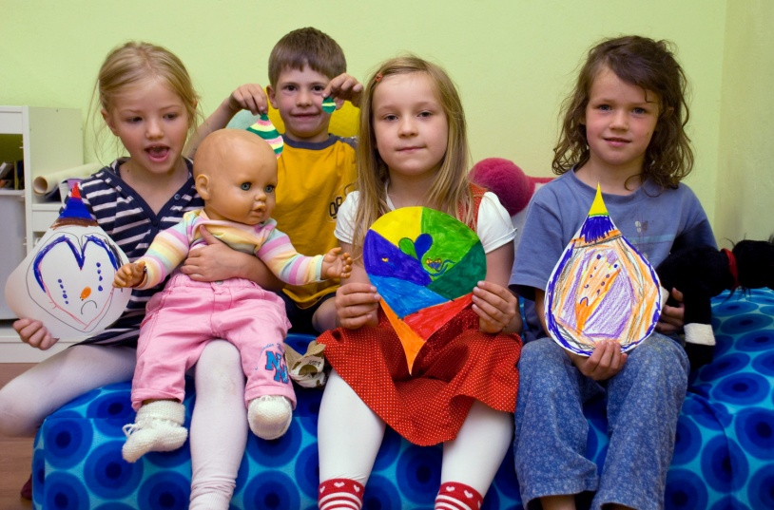
3rd prize
2009
Death of a Close Family Member or Friend
Austria
Helps children and their families deal with the inevitable
Shows death as a normal part of life
To protect children from the taboo on death

Slide 6
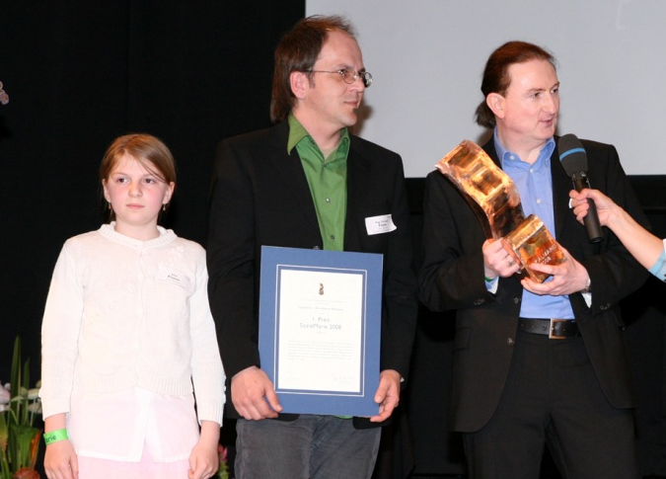
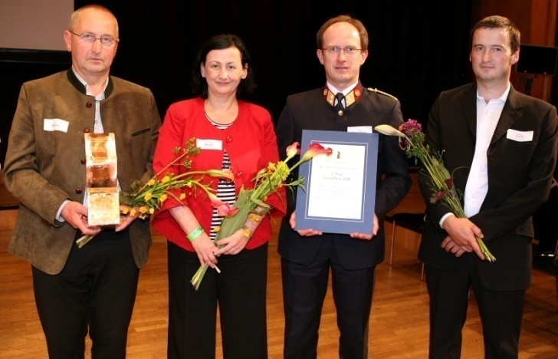
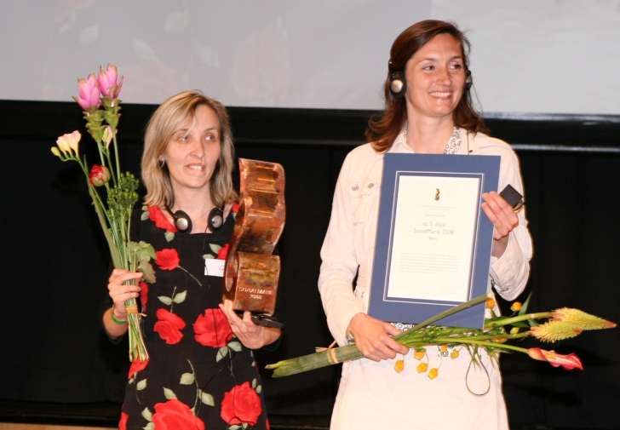
2008
1st prize
living books - the live library
Austria
2nd prize
SBS - Small Business Starter
Austria
3rd prize
Roma Help Roma
Hungary

Slide 7
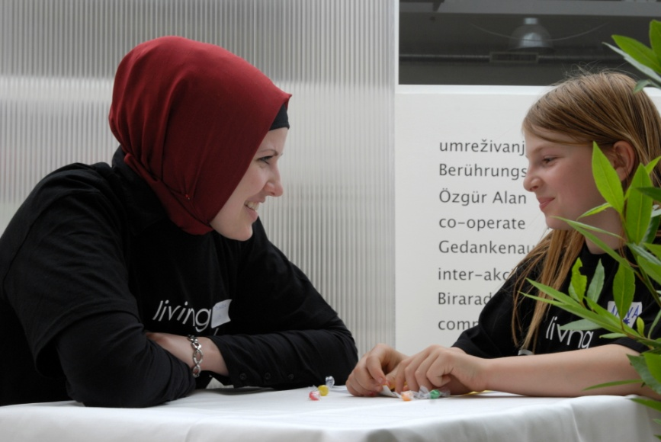
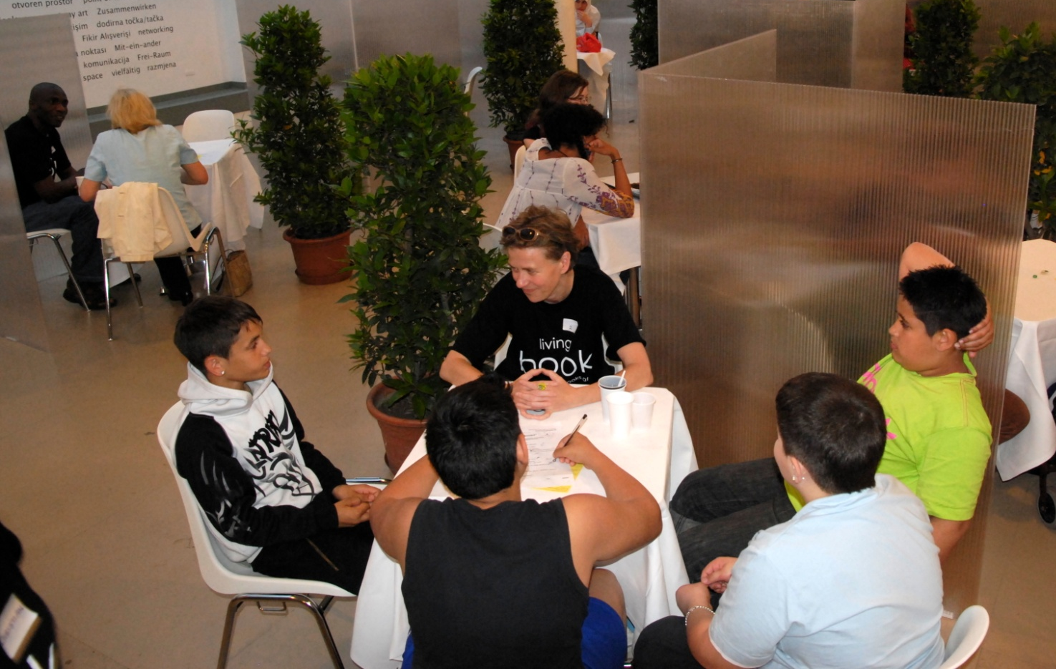
1st prize
2008
living books - the live library
Austria
Men and women represent prejudices and stereotypes
The “reader” talks to the chosen book
A respectful dialogue can take place - everywhere

Slide 8
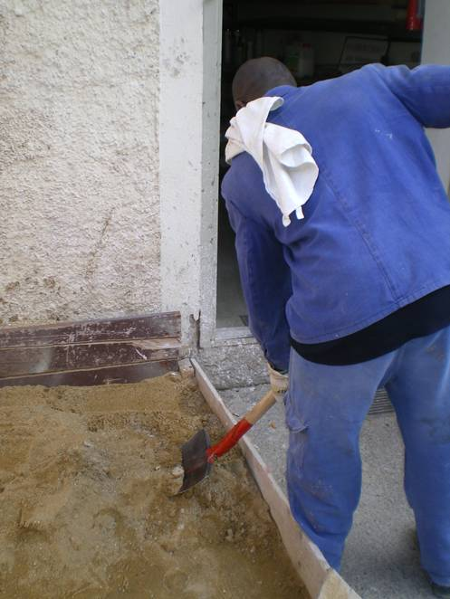
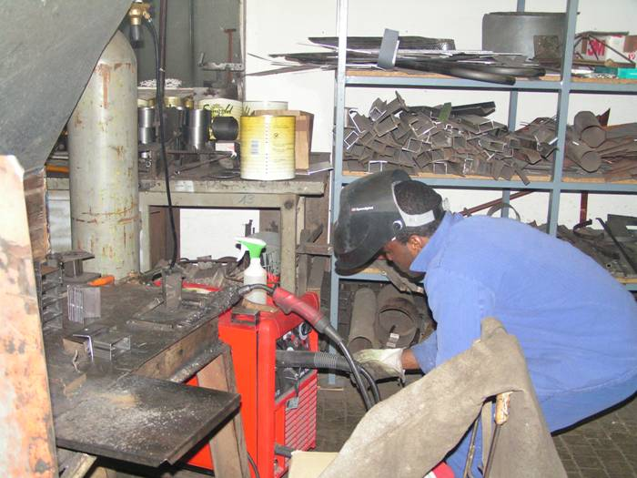
2nd prize
2008
SBS - Small Business Starter
Austria
Target group: black offenders who are facing deportation
Initiators: prison officers
Aim: to learn a trade for a new start

Slide 9
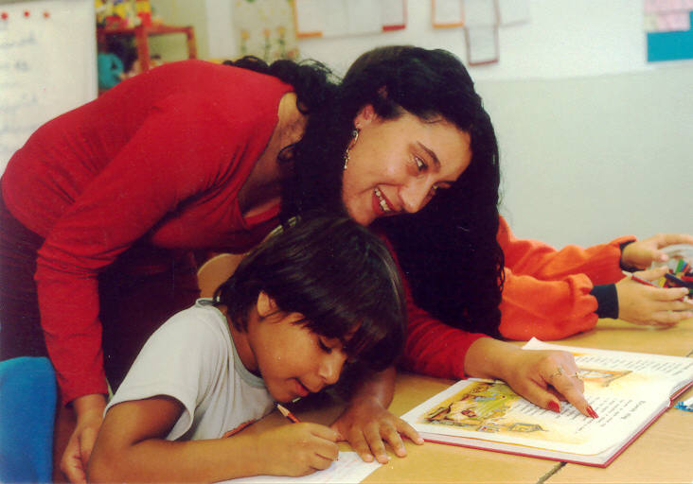
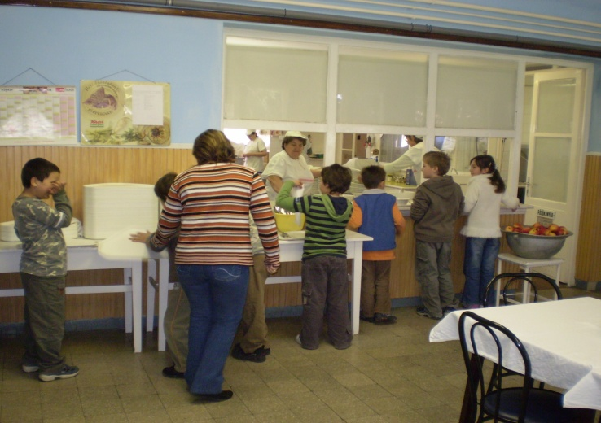
3rd prize
2008
Roma Help Roma
Hungary
Roma mediate between teachers, pupils and the
communities
To create role models for Roma and non-Roma
Successfully combines education, work and intercultural
dialogue

Slide 10
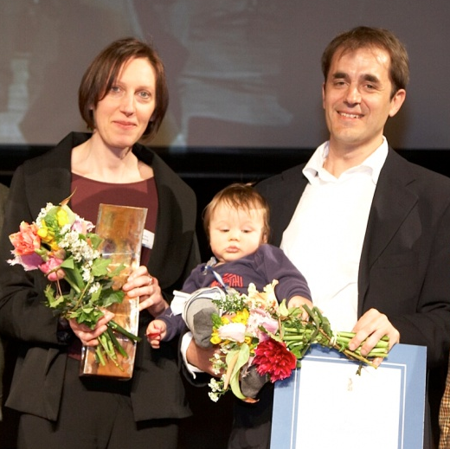
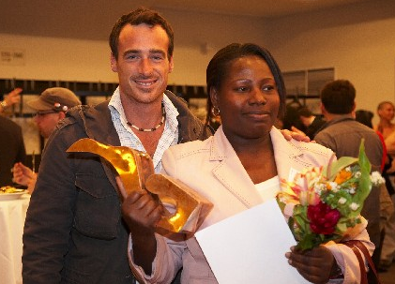
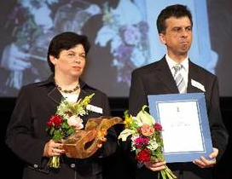
2007
1st prize
Connecting People
Austria
2nd prize
Black Austria
Austria
3rd prize
The Second Viennese Savings Bank
Austria

Slide 11
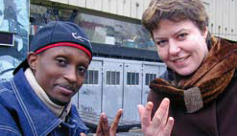
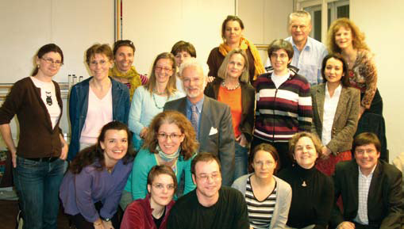
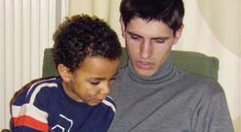
1st prize
2007
Connecting People
Austria
Volunteers as 'godparents' for unaccompanied minor
refugees
Help the minor refugees to find their feet in an alien world
Concrete solidarity as political action

Slide 12
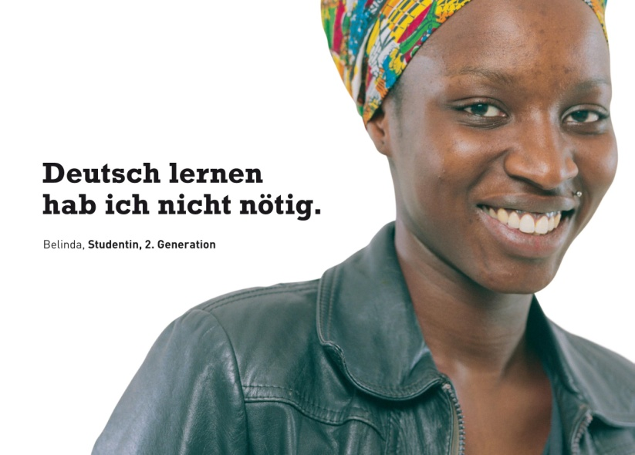
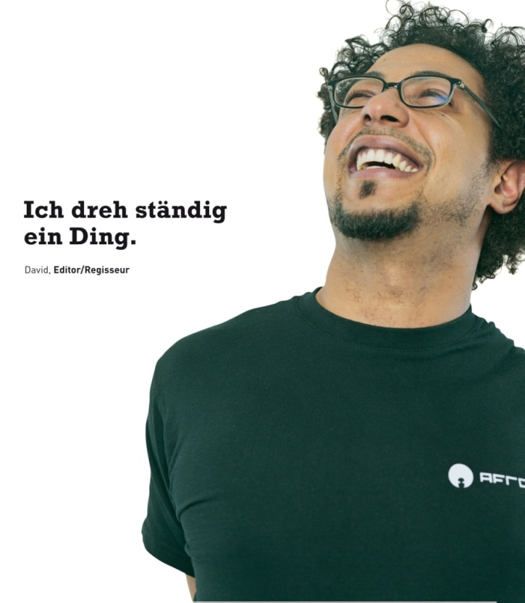
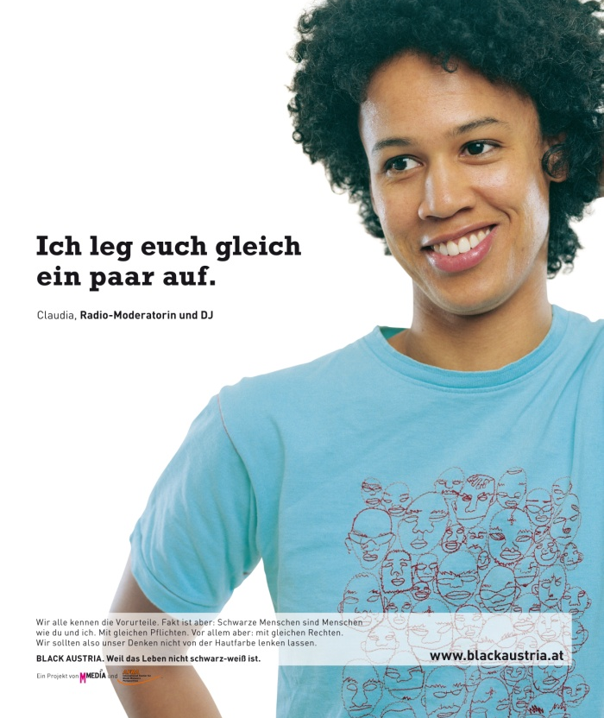
2nd prize
2007
Black Austria
Austria
To cure the lack of knowledge about black people
Posters present self-portraits with intentionally
provocative texts
To integrate non-cliché pictures of blacks into Austrian
minds

Slide 13
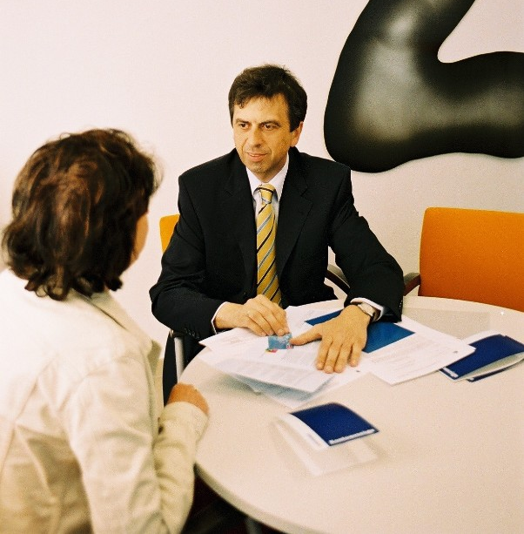
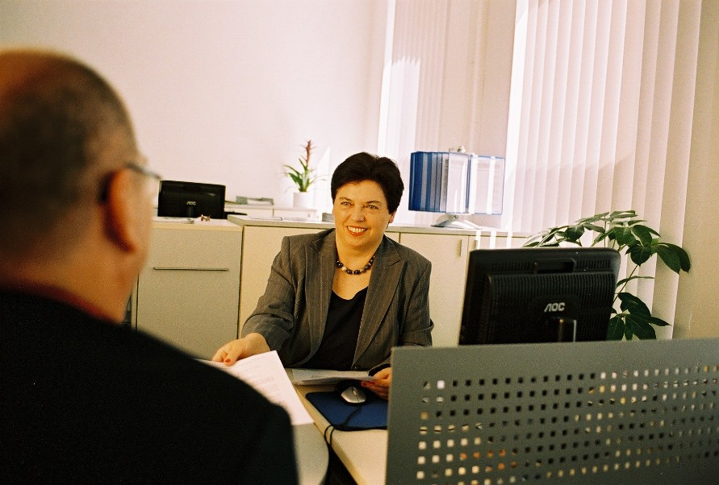
3rd prize
2007
The Second Viennese Savings Bank
Austria
For bankrupt people without access to a bank account
To facilitate re-entry into normal life
Prepared and accompanied by debt counselling

Slide 14
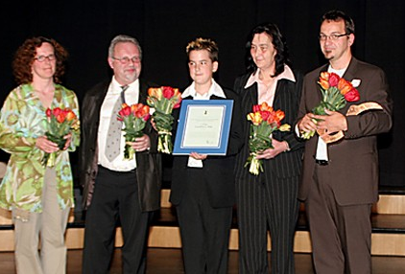
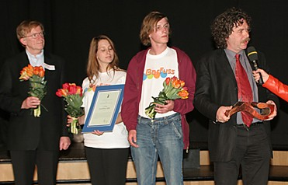
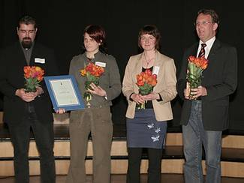
2006
1st prize
M.U.T. - C.O.U.R.A.G.E.
Austria
2nd prize
Barfuss – a Bar with a Twist
Austria
3rd prize
2getthere Burgenland
Austria

Slide 15
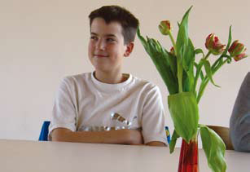
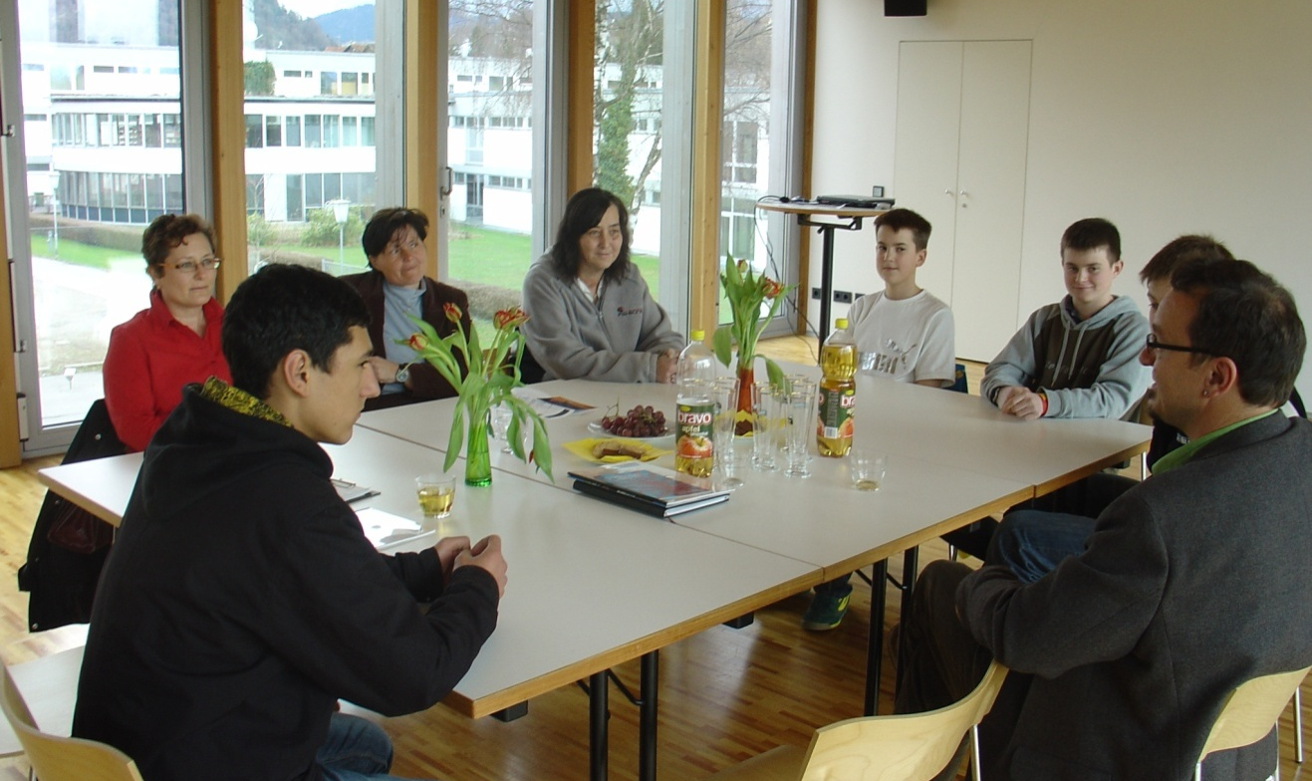
1st prize
2006
M.U.T. - C.O.U.R.A.G.E.
Austria
Motivation and Training towards the end of compulsory
schooling
Gives teenage pupils the courage they need for an
active start into working life
High success rate, based on excellent networking

Slide 16
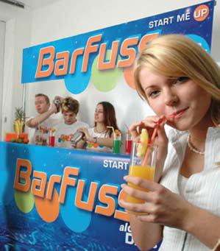
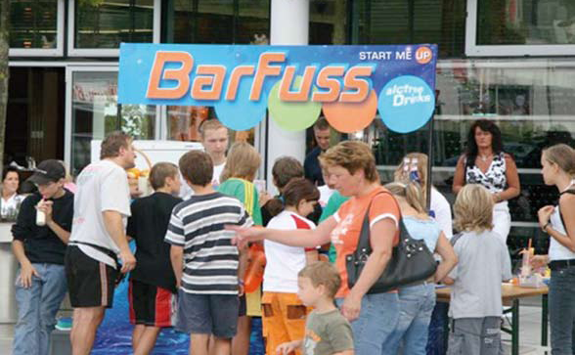
2nd prize
2006
Barfuss – a Bar with a Twist
Austria
Addiction prevention by young people for young people
A mobile bar provides alcohol-free cocktails at
affordable prices
To talk about alcohol, the legal drug, and how to avoid it

Slide 17
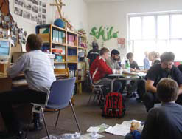
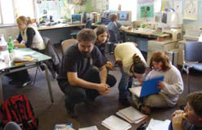
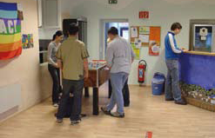
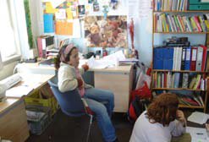
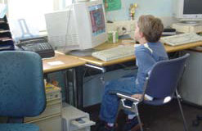
3rd prize
2006
2getthere Burgenland
Austria
Senior pupils help their junior colleagues overcome
school problems
Assists children and teenagers from difficult social
background
Resulting friendship bonds youths from different classes
and ways of life

Slide 18
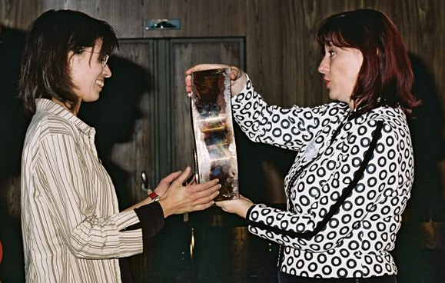
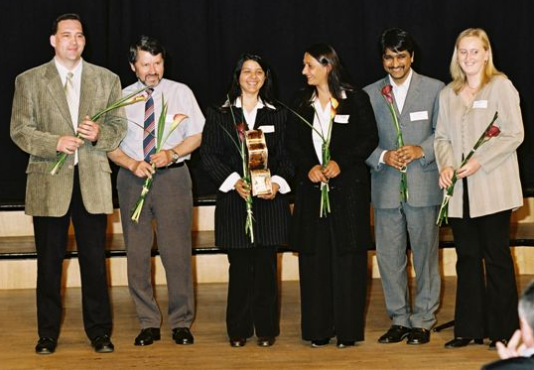
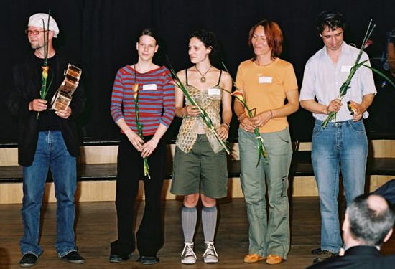
2005
1st prize
www.deserteursberatung.at
Austria
2nd prize
Roma Police Assistants Programme
Czech Republic
3rd prize
Your Viewture
Austria

Slide 19
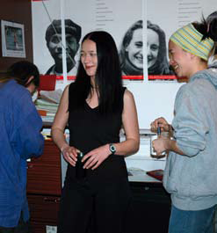
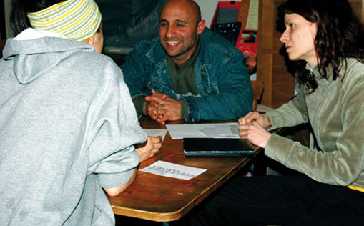
1st prize
2005
www.deserteursberatung.at
Austria
Information platform, 24/24, run by multi-professional
volunteers
Website-Counselling on asylum and immigration in
Austria, in several languages
Complex issues dealt with comprehensibly

Slide 20
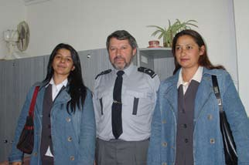
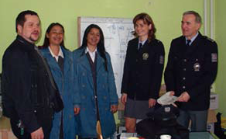
2nd prize
2005
Roma Police Assistants Programme
Czech Republic
Roma women accompany and advise police officers in
their work
Fights against usurers and their extortionate interest rates
Roma people regain trust in state authorities

Slide 21
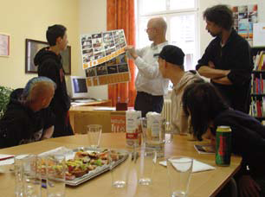
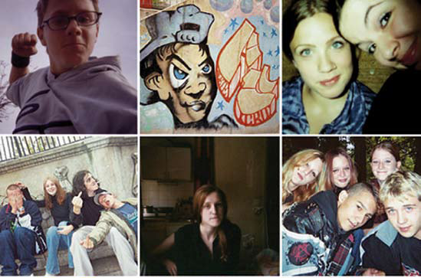
3rd prize
2005
Your Viewture
Austria
Young people in rural areas visualise their life
Disposable cameras as tools and media
The printed photographs provoke discussions about
what is important

